Slide 1
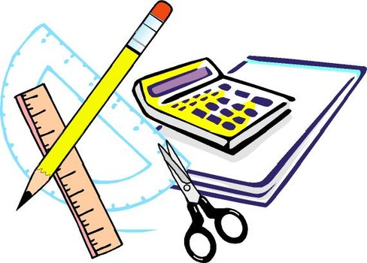
Learning Objective
I will identify mutually exclusive events.
Enter quietly, please be ready with the following on your desk:
Whiteboard
Whiteboard marker
Exercise Book
Pencil, pen, ruler and red pen
Diary
Calculator
Device – charged or borrowed from Library before maths

Slide 2








Daily Review
Number of successful outcomes Number of outcomes in total
$$\frac{3}{5}$$
Pr(red)
Pr(blue)
Pr(H)
Pr(M)
Pr(vowel)
Pr(consonant)
Pr(letter)
$$\frac{2}{5}$$
M A
T H E
M A T
I C S
$$\frac{1}{11}$$
$$\frac{2}{11}$$
$$\frac{4}{11}$$
$$\frac{7}{11}$$
$$\frac{11}{11}=1$$

Slide 3



Daily Review
 | Year 7 | Year 8 | Year 9 | TOTAL
Boys | 9 | 8 | 12 | 29
Girls | 4 | 10 | 7 | 21
TOTAL | 13 | 18 | 19 | 50
If I was to choose a pupil at random, what is the probability of selecting a Year 8 pupil?
Pr(Year 8) =
What is the probability that a pupil selected at random will be a boy?
Pr(boy) =
If a Year 7 pupil is selected, what is the probability that they are a girl?
Pr(girl if Year 7) =
$$\frac{18}{50}=\frac{9}{25}$$
 | Year 7 | Year 8 | Year 9 | TOTAL
Boys | 9 | 8 | 12 | 29
Girls | 4 | 10 | 7 | 21
TOTAL | 13 | 18 | 19 | 50
$$\frac{29}{50}$$
 | Year 7 | Year 8 | Year 9 | TOTAL
Boys | 9 | 8 | 12 | 29
Girls | 4 | 10 | 7 | 21
TOTAL | 13 | 18 | 19 | 50
$$\frac{4}{13}$$

Slide 4
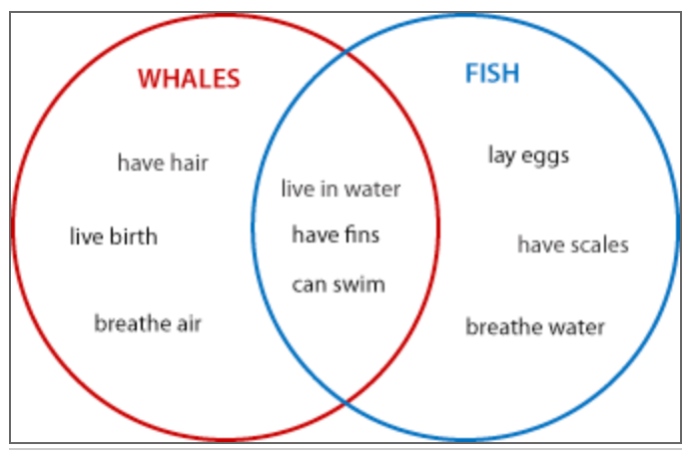
Daily Review
Unions and Intersections
OR = Union (all circles)
AND = Intersection (overlap)
Anything you can tell me about whales OR fish is the union of whales and fish.
Anything that is common to whales AND fish is the intersection of whales and fish.
The union of A and B is everything in A or B.
The intersection of A and B is everything that’s in both A and B.

Slide 5
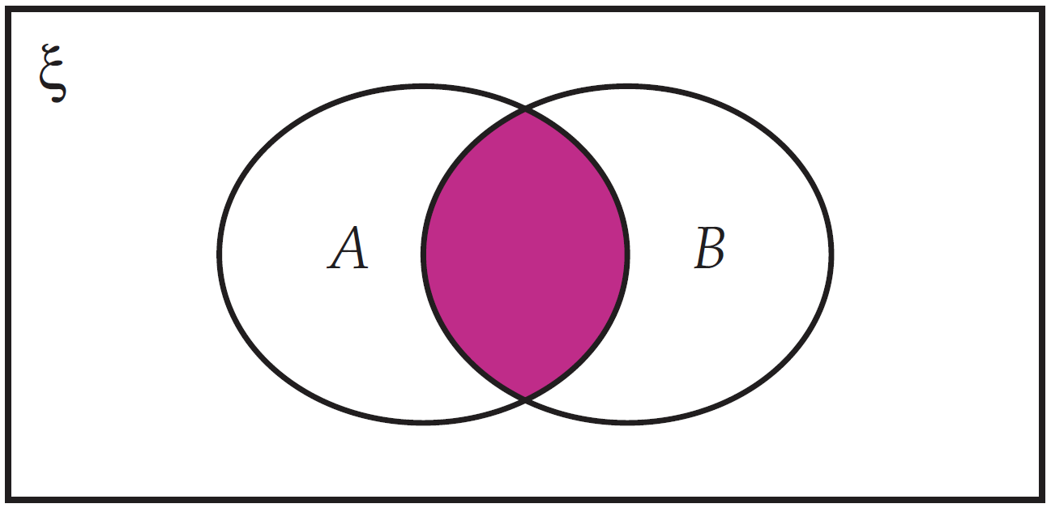
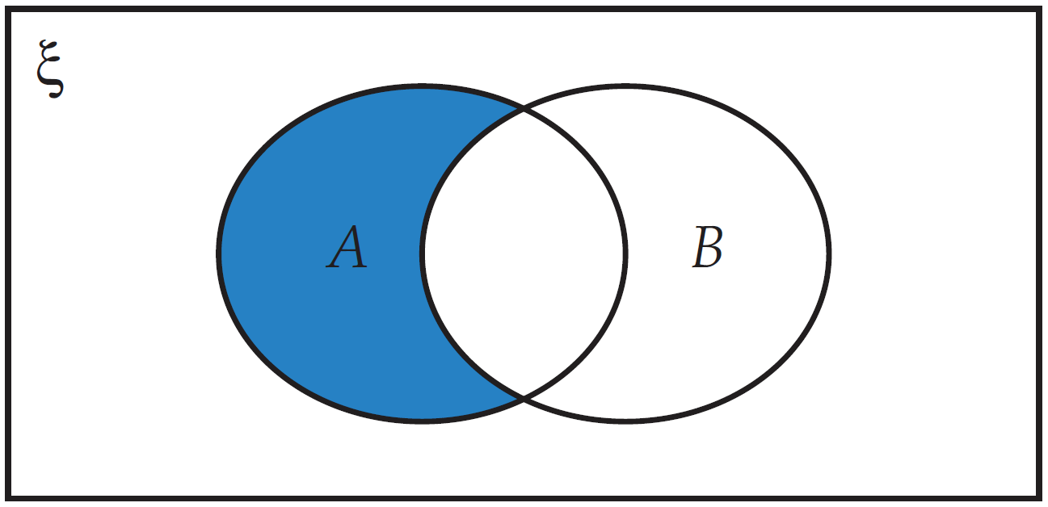
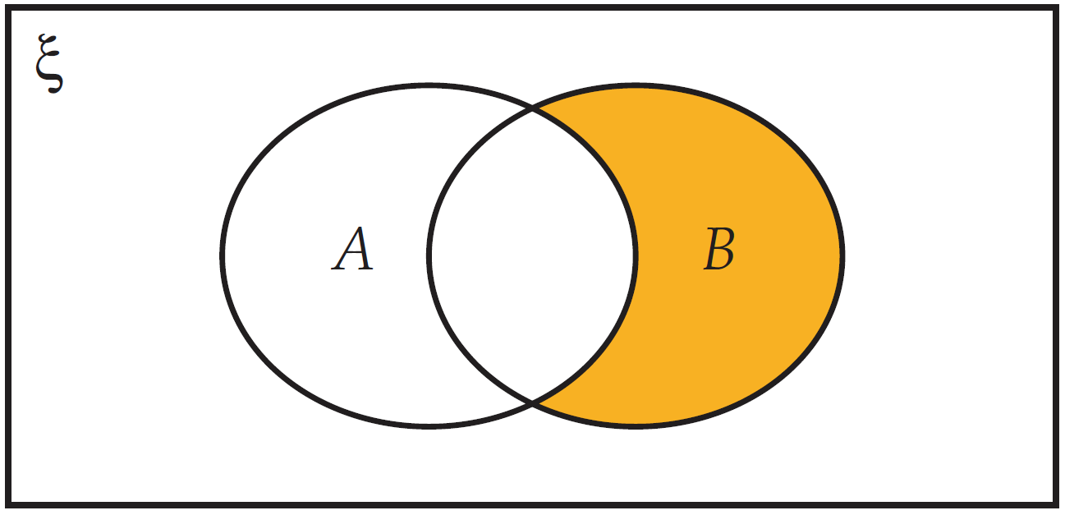
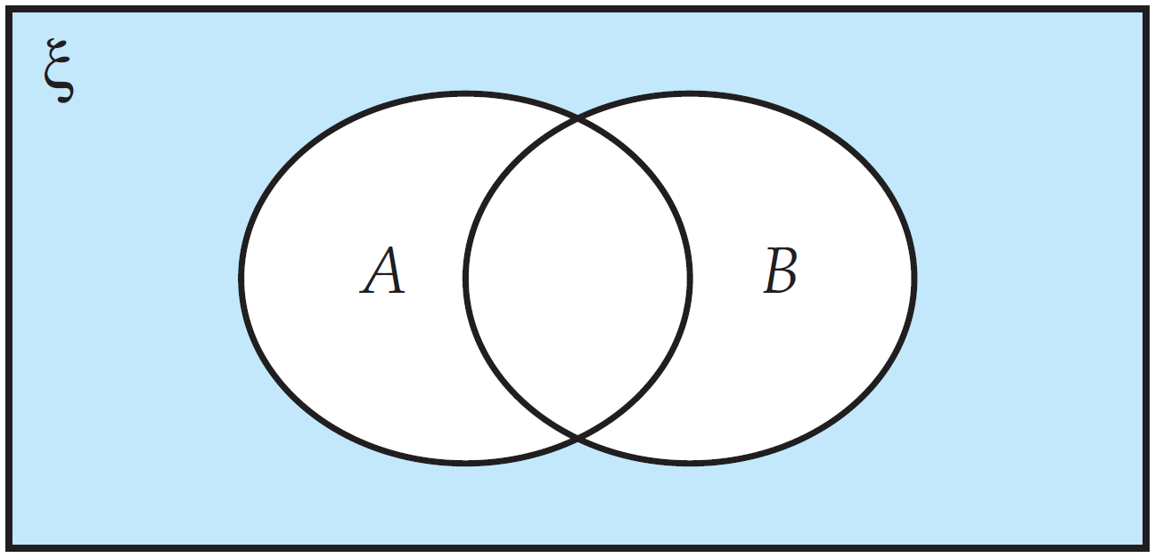
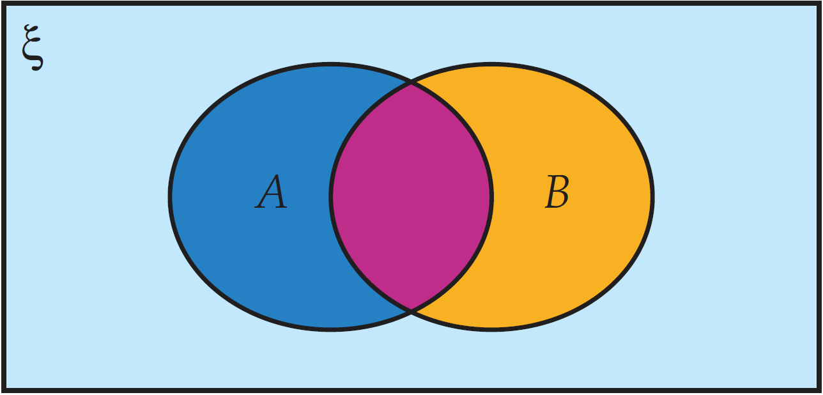
Daily Review
There are 5 areas to this Venn diagram.
This is the intersection of A and B. It is where both A and B occur.
This is the remainder of A. It is where A occurs but B does not.
This is the remainder of B. It is where B occurs but A does not.
This is any outcomes which do not fit into A or B.
This is the union of A and B.
It is anything within A or B.

Slide 6
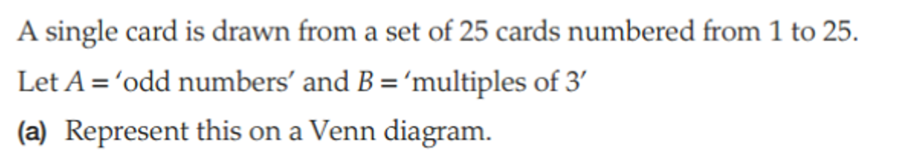
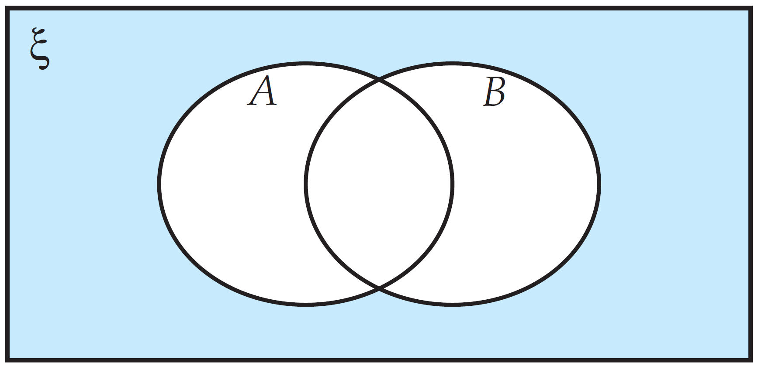
Daily Review

Slide 7
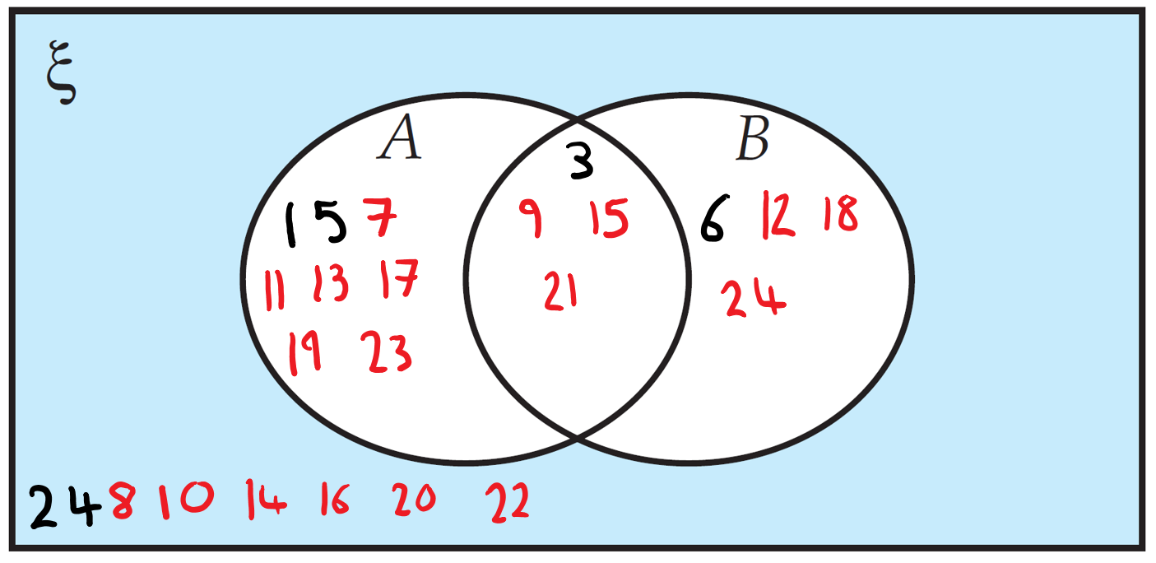
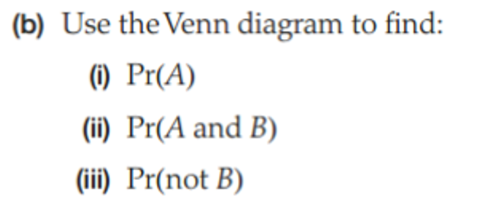



Daily Review
$$\frac{9+4}{25}=\frac{13}{25}$$
$$\frac{4}{25}$$
$$1−\frac{8}{25}=\frac{17}{25}$$

Slide 8
Learning Objective
CFU 1
What will we learn?
I will identify mutually exclusive events.
CFU 2
What will we learn?
CFU 3
How will we know if we’ve been successful?
Success Criteria
CFU 4
How will we know if we’ve been successful?
I will be able to:
Decide whether events are mutually exclusive or not.
Calculate probabilities from mutually exclusive events.
Calculate probabilities from events that are not mutually exclusive.

Slide 9

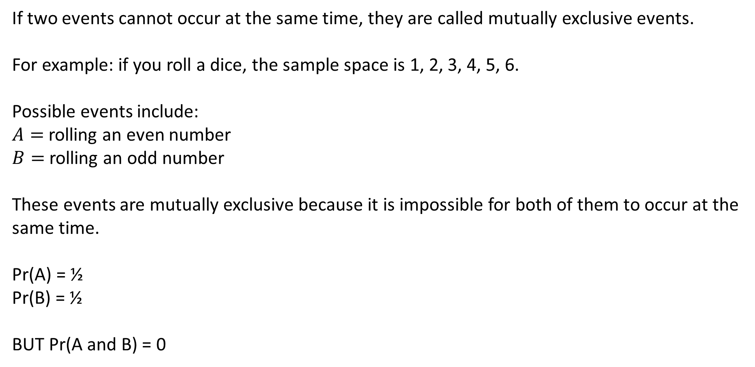
Concept Development
CFU 1
What are mutually exclusive events?
If two events cannot occur at the same time, they are called mutually exclusive events.
For example: if you roll a dice, the sample space is 1, 2, 3, 4, 5, 6.
Possible events include:
$A=$rolling an even number
$B=$rolling an odd number
These events are mutually exclusive because it is impossible for both of them to occur at the same time.
Pr(A) = ½
Pr(B) = ½
BUT Pr(A and B) = 0

Slide 10
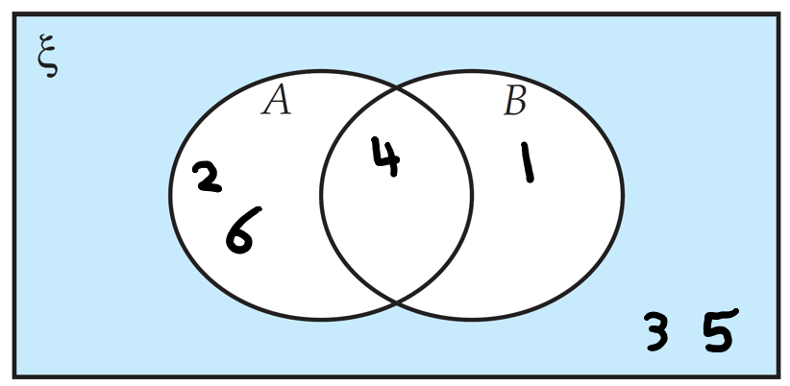
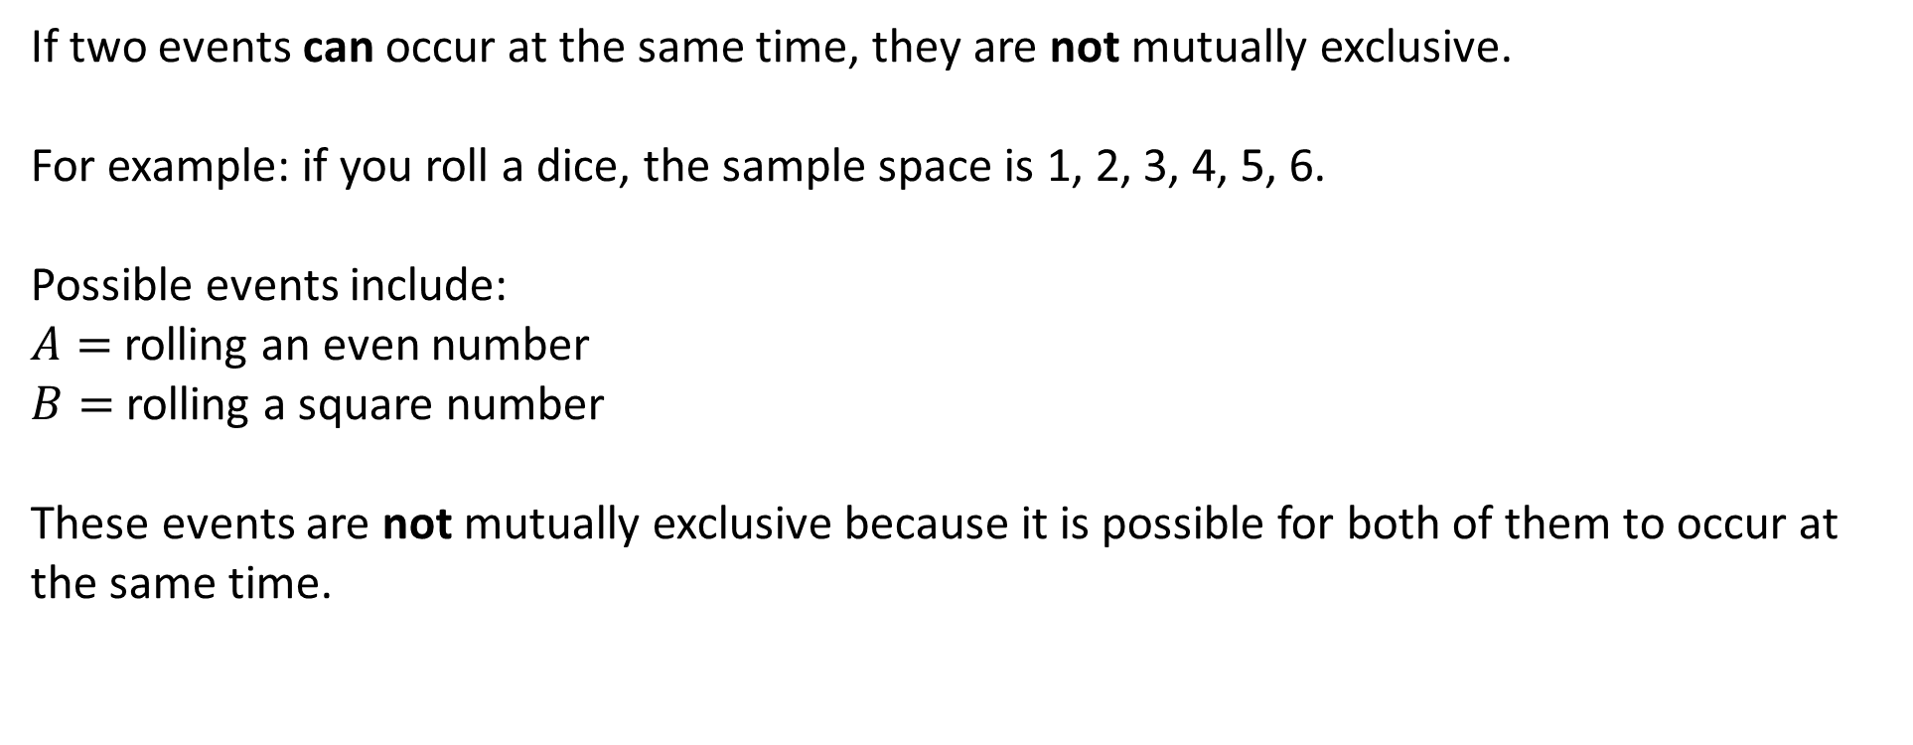
Concept Development
CFU 1
What are mutually exclusive events?
If two events can occur at the same time, they are not mutually exclusive.
For example: if you roll a dice, the sample space is 1, 2, 3, 4, 5, 6.
Possible events include:
$A=$rolling an even number
$B=$rolling a square number
These events are not mutually exclusive because it is possible for both of them to occur at the same time.
4 is both an even number and a square number, so A and B can occur at the same time.

Slide 11
Skill Development
If two events cannot occur at the same time, they are called mutually exclusive events.
If two events can occur at the same time, they are not mutually exclusive.
Decide whether the following events are mutually exclusive or not.
Tossing a coin and getting a heads and tossing a coin and getting a tails.
ME
Winning a football game and losing the same football game.
ME
ME
Picking a red card from a deck of cards and picking a black card from a deck of cards.
Not ME
Picking a red card from a deck of cards and picking a Jack, Queen or King.
ME
Catching a bus and missing the same bus.
Not ME
Watching a comedy movie and watching a romantic movie.
Not ME
Rolling the number 2 on a dice and rolling a number less than 4 on a dice.
A traffic light being red and a traffic light being green.
ME
Not ME
A traffic light being red and the pedestrian crossing being green.

Slide 12
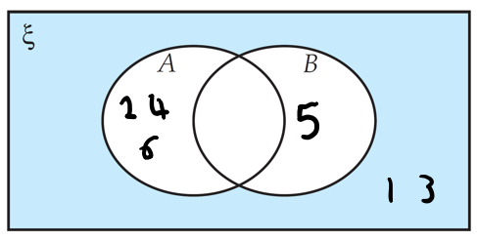

Skill Development
If two events cannot occur at the same time, they are called mutually exclusive events.
If two events can occur at the same time, they are not mutually exclusive.
If you roll a dice, the sample space is 1, 2, 3, 4, 5, 6.
$A=$rolling an even number
$B=$rolling a 5
These events are mutually exclusive.
$$\operatorname{Pr}\left(A\right)= \frac{3}{6}=\frac{1}{2}$$
$$\operatorname{Pr}\left(B\right)= \frac{1}{6}$$
$$\operatorname{Pr}\left(A or B\right)= \frac{3}{6}+\frac{1}{6}=\frac{4}{6}=\frac{2}{3}$$
Addition rule for mutually exclusive events:
Pr(A or B) = Pr(A) + Pr(B)

Slide 13
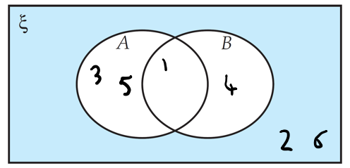

Skill Development
If two events cannot occur at the same time, they are called mutually exclusive events.
If two events can occur at the same time, they are not mutually exclusive.
If you roll a dice, the sample space is 1, 2, 3, 4, 5, 6.
$A=$rolling an odd number
$B=$rolling a square number
These events are not mutually exclusive.
$$\operatorname{Pr}\left(A\right)= \frac{3}{6}=\frac{1}{2}$$
$$\operatorname{Pr}\left(B\right)= \frac{2}{6}=\frac{1}{3}$$
$$\operatorname{Pr}\left(A or B\right)= \frac{3}{6}+\frac{2}{6}−\frac{1}{6}=\frac{4}{6}=\frac{2}{3}$$
General addition rule:
Pr(A or B) = Pr(A) + Pr(B) – Pr(A and B)

Slide 14
Guided Practice
Addition rule for mutually exclusive events:
Pr(A or B) = Pr(A) + Pr(B)
General addition rule:
Pr(A or B) = Pr(A) + Pr(B) – Pr(A and B)
A standard dice is rolled. Find the probability of rolling each of the following numbers.
A 2 or a 5
An odd number or a number greater than 3
Odd or a 4.
ME
Not ME
ME
a)
Pr(A) = 1/6
Pr(B) = 1/6
Pr(AorB) = 1/6 + 1/6
= 2/6 = 1/3
b)
Pr(A) = 3/6
Pr(B) = 3/6
Pr(AandB) = 1/6
Pr(AorB) = 3/6 + 3/6 - 1/6
= 5/6
c)
Pr(A) = 3/6
Pr(B) = 1/6
Pr(AorB) = 3/6 + 1/6
= 4/6 = 2/3

Slide 15
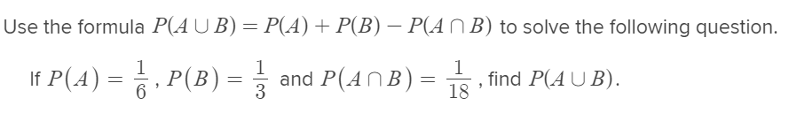
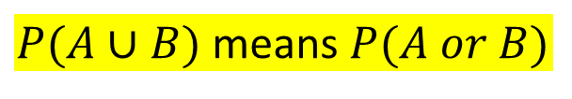
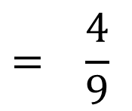
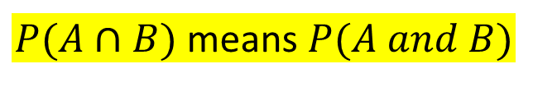
Guided Practice
Addition rule for mutually exclusive events:
Pr(A or B) = Pr(A) + Pr(B)
General addition rule:
Pr(A or B) = Pr(A) + Pr(B) – Pr(A and B)
$P(A∪B)$ means $P(A or B)$
$P(A∩B)$ means $P(A and B)$
$$P\left(A∪B\right)=P\left(A\right)+P\left(B\right)−P(A∩B)$$
$$P\left(A∪B\right)= \frac{1}{6} + \frac{1}{3} − \frac{1}{18}$$
$$= \frac{4}{9}$$

Slide 16
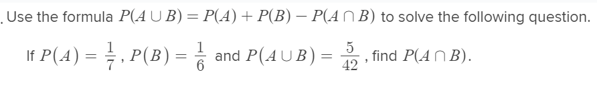
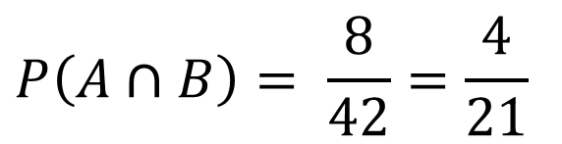
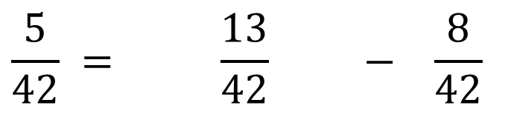
Guided Practice
Addition rule for mutually exclusive events:
Pr(A or B) = Pr(A) + Pr(B)
General addition rule:
Pr(A or B) = Pr(A) + Pr(B) – Pr(A and B)
$P(A∪B)$ means $P(A or B)$
$P(A∩B)$ means $P(A and B)$
$$P\left(A∪B\right)=P\left(A\right)+P\left(B\right)−P(A∩B)$$
$$\frac{5}{42} = \frac{1}{7} + \frac{1}{6} − P(A∩B)$$
$$\frac{5}{42} = \frac{13}{42} − \frac{8}{42}$$
$$P\left(A∩B\right)= \frac{8}{42}=\frac{4}{21}$$

Slide 17
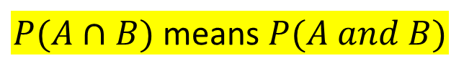
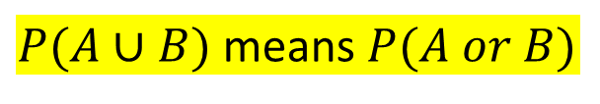
Independent Practice
If two events cannot occur at the same time, they are called mutually exclusive events.
If two events can occur at the same time, they are not mutually exclusive.
Decide whether the following events are mutually exclusive or not.
Addition rule for mutually exclusive events:
Pr(A or B) = Pr(A) + Pr(B)
General addition rule:
Pr(A or B) = Pr(A) + Pr(B) – Pr(A and B)
$P(A∪B)$ means $P(A or B)$
$P(A∩B)$ means $P(A and B)$
Mathspace – Year 10 Mainstream Mutually Exclusive Events CLASS WORK

